Slide 1
Volian Enterprises
PROcedure Maintenance System (PROMS) for AP-1000 Builders Group
Presented September 14, 2010
by:
Volian Enterprises, Inc.
(724) 335-3744
www.volian.com

Slide 2
Purpose of Meeting
Support AP-1000 Builder’s Group Evaluation of Procedure Maintenance Systems to be Documented in October Whitepaper
  Describe VE-PROMS and PROMS2010
  Address Comments and Questions
Builder’s Group Objectives:
  To implement advanced state of the art tools for
    the development and maintenance of plant procedures (with the exception of EOPs and AOPs).
    the electronic performance of procedures.
    (Richard Browder’s e-mail 06/08/09)

Slide 3
Produce highest quality NPP procedures at a reasonable cost throughout the plant lifetime
Procedure maintenance needs to strive for continuous improvement of the procedures
A Procedure Maintenance System provides features that:
  Simplify and automate critical elements of the procedure maintenance workflow process
  Utilize up-to-date technology
  Provides a solid foundation for future technology improvements
  Utilize highly trained personnel more Effectively and Efficiently
  Facilitate procedure creation and conversion
  Manage hyperlinks
  Embed Writer’s Guide format
  Track the history of changes to the procedures
  Interfaces with supporting documents
  Insure technical accuracy and consistency
  Reduce and eliminate errors
  Incorporate human factors principles
  Interacts with the man-machine interface
  Provide a framework for continuous improvement over plant lifetime.
Improved procedures improve plant performance

Slide 4
Volian’s PROcedure Maintenance System
Volian’s core business:
  Supporting nuclear plant procedures
  25 years experience
VE-PROMS and PROMS2010
  Designed to create and maintain highly structured documents that change over time
  Based on a database design where content is separated from the embedded structure and format definitions
  The current procedure maintenance system, called VE-PROMS, is currently used by most of the Builder’s Group utilities.
  The new procedure maintenance system is called PROMS2010. It will have staged releases starting in late 2010 and continuing through 2011.

Slide 5
Westinghouse Plants that use VE-PROMS
Users w Current Version
  Callaway
  D.C. Cook
  R.E. Ginna
  Catawba Units 1 and 2*
  McGuire Units 1 and 2*
  Indian Point Units 2 and 3
  Braidwood Units 1 and 2
  Byron Units 1 and 2
  Point Beach Units 1 and 2*
  Prairie Island Units 1 and 2
  Shearon Harris*
  Farley Units 1 and 2*
  South Texas Project Units 1 & 2
  Comanche Point Units 1 and 2
  Kewaunee Units 1 and 2
  Wolf Creek
  H.B. Robinson*
  Turkey Point Units 3 and 4*
Users w Older Versions
  North Anna Units 1 and 2
  Surry Units 1 and 2
  Seabrook*
  Diablo Canyon Units 1 and 2
  V.C. Summer*
  Vogtle Units 1 and 2*
Non-Users
  Millstone Unit 3
  Beaver Valley Units 1 and 2
  Salem Units 1 and 2
  Sequoyah Units 1 and 2*
  Watts bar*
  *Plants operated by potential
  AP-1000 owners

Slide 6
PROMS2010 Staged Releases
Initial Prototype Version (Ready Now)
  Installed on Local Computer
  Has Data Conversion, Built in Format, Tree View Procedure Selection, Word Attachments, Procedure Editor, Global Search, Annotations, ROs, Transitions, PDF Print, Smart Pagination, Change Bars
Next Version (1st Qtr 2011)
  Step Editor Enhanced Tables
  Multi-User Network Version
  Additional Plant Data Converted (approx. 5 plants)
  Collecting Procedure Change Data
  Third Party Approval
Adding Functionally (2011)
  Change Manager
  Enhanced Approval Process (Internal to PROMS)
  Auxiliary & Supporting Documents e.g. Background Documents
  Master/Slave
  Reports
Delivery To Existing Customers (2011)
  Data Conversion
  Depends on Volume of Data, Advanced Functions, and Plant Specific Features/Format

Slide 7
PROMS2010 Staged Releases (cont.)
New Build Plant Enhancements AP-1000, EPR, US-APWR, ABWR (2012 – 20xx)
Anticipated Improvements (2012 – 20xx)
  Selected Workflow Enhancements
  Automated Testing and Data Checking
  Step Editor Library Documents
  Standard Steps (one to many)
  Partial Approval

Slide 8
PROMS2010
Complete Rewrite of Program
  Based upon VE-PROMS Functionality – Modernize and Improve
  Incorporates improvements based on many years of procedure writer feedback
  Utilizes modern day equipment and software capabilities
  New development environment (.NET Framework, MS Visual Studio, C#)
  New database design (SQL server)
Modern/State-of-the-Art User Interface
  Tabs and ribbons (e.g. MS Office 2007)
  Tree view of folders/procedures (like Windows Explorer)
  Expand/Contract sections/steps
  Better utilization of the entire screen(s)
More Capable
  Fully integrated with MS Word for Accessory Pages
  Generalized and extensible annotation functionality replaces Comment Field
  Better integration with supporting documents (background and deviation documents)
  Improved table editing
  Integration of .pdf file creation for printing and document control
Notes:
New User Interface
Tabs & Ribbons
Show the panes
Tree View
RO Interface
WORD Attachments
Multi Screen Display
Embedded Step Structure
Improved Search
Additional Features & Capabilites
Sorting results
Real time menu updating

Slide 9
Referenced Objects
  What are Referenced Objects
  Procedure content stored in a database that can be linked to multiple locations in the procedure sets.
  Results in consistent usage within procedure text and lower maintenance costs.
Examples Of Referenced Object Content
  Setpoints – procedure decision criteria in the form of text, tables, plots, figures
  Equipment – IDs, nameplates, location
  Action Verbs, Acronyms, Figures, Standard text, and References
Unique and Robust
  User interface designed for procedure maintenance
  Additional information associated with each object (basis, description, …)
  Multiple output values for each object (equipment ID, nameplate value, location)
  Managed Links (procedure writer controls updates)
  Standard reports including complete, summary, and usage reports
  Search for referenced objects to identify impacted procedures
Notes:
Unit/Train dependent values

Slide 10
Master/Slave Procedure Editing
Can be applied to duplicate or similar sets of procedures
Edit single procedure (“Master”) to create multiple non-editable procedures (“Slaves”)
Manages:
  unit, site, channel, or train information on procedure titles and designations
  unit, site, channel, or train information on equipment designations
  applicability of different step and sub-step content
Assures consistency across units, sites, channels, trains, etc.
Minimizes procedure writers’ effort to create similar procedures
Ideal for:
  Multiple sites/units
  Multiple instrument channels
  Multiple equipment trains

Slide 11
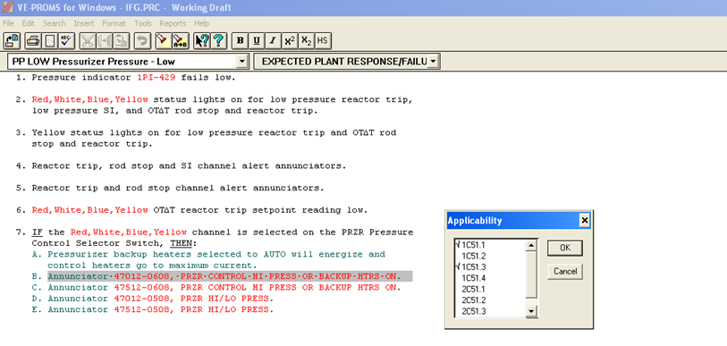
Master
Master contains the information for all units and channels
This step 7B, is applicable for unit 1, channels Red and Blue

Slide 12
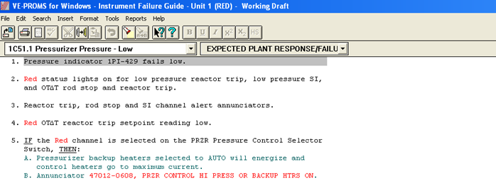
Slave
Slave contains only information pertaining to only one unit and channel; e.g. Unit 1, Red

Slide 13
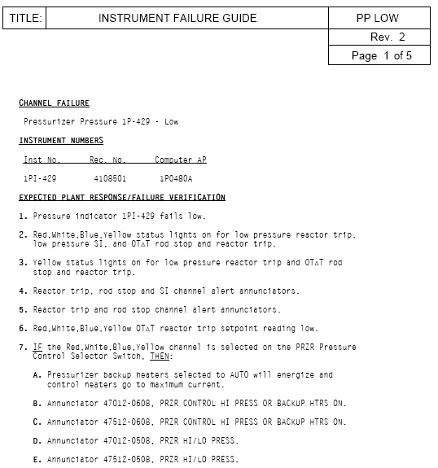
Master

Slide 14
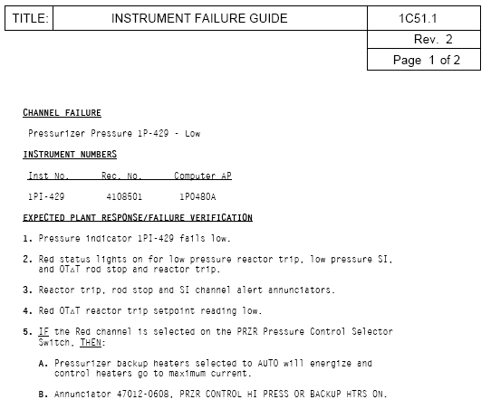
Slave

Slide 15
Westinghouse Generic Procedures
Site A Procedures
Site B Procedures
Site C Procedures

Slide 16
Unit 1
Slave Procedures
Unit 2
Slave
Procedures
Site A Master Procedures

Slide 17
Advantages of our Database Design
Separate Format & Content
  Allows for Rapid incorporation of Writer’s Guide Changes
    Simply change the format file, and all working draft procedures will be changed to reflect the new writer’s guide
  Allows the procedure data to be reformatted for use in many different ways
    Data can be formatted for use on various displays
    such as PDAs, Notebooks, Large Display Panels, etc.
    Data can be formatted for other documents such as Procedure Lesson Plans
    Data can also be formatted for use with electronic procedures

Slide 18
PROMS2010 Output
Procedure
Predefined Reports
  Change Management
    Summary displays only final changes made to a single procedure or set
    Chronology displays all changes made to a single procedure or set
  Referenced Objects
    Lists all the information in the RO database
    Provides a short description of each object in the RO database
    Lists all procedures with step number that the RO is used
  Transition Usage
    Lists all procedure steps that transitions to the selected one
  Search
Customized Displays
  PDA, iPad, Tablet, etc.
  Flat panel displays

Slide 19
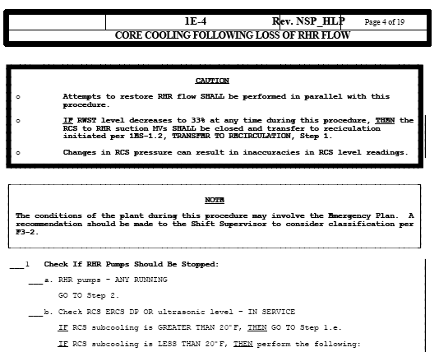
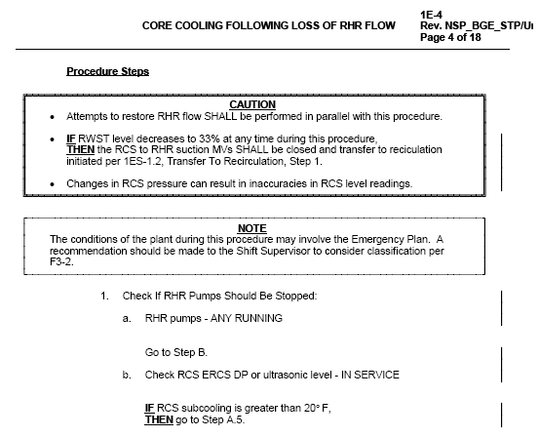
Universal Format Changes
PROCEDURE FORMAT 1
PROCEDURE FORMAT 2
Note: Different Header, different line width on boxes, Checkoff Lines on left format, “Then” starting on a new line on Right format (2nd Caution).

Slide 20
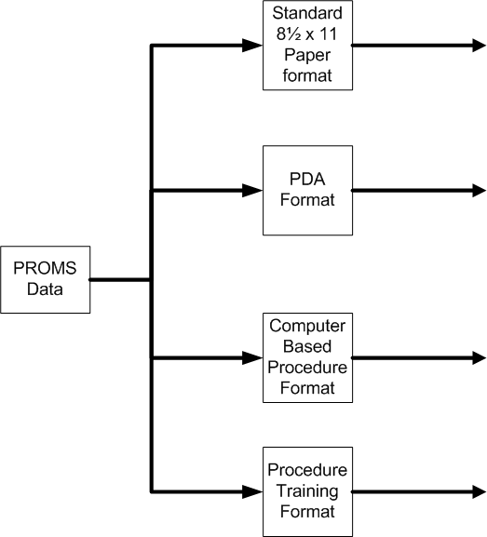




PROMS2010 Outputs

Slide 21
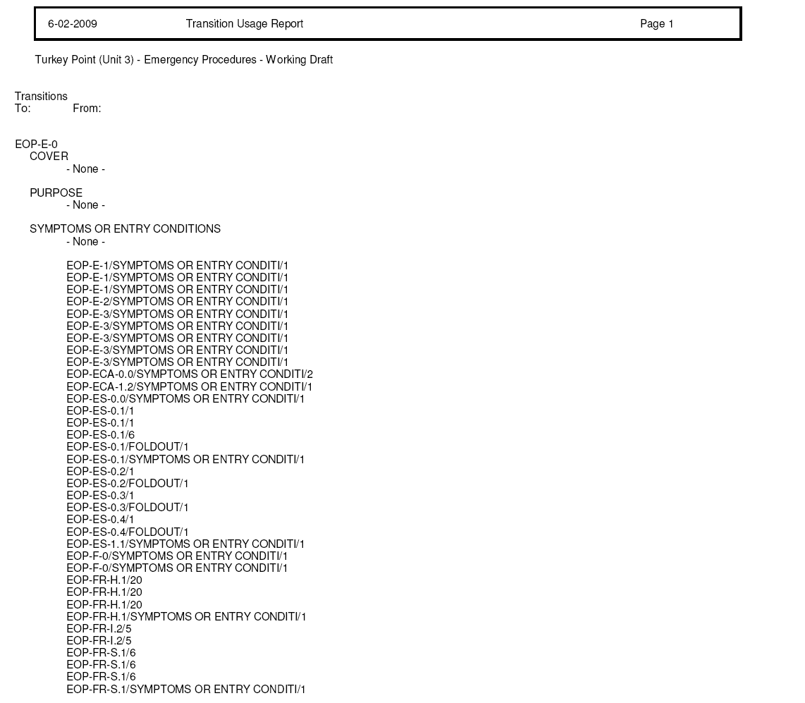
Sample Transition Usage Report
List of Transitions to Procedure E-0

Slide 22

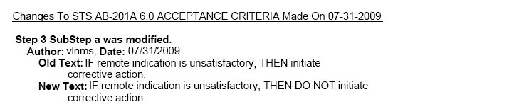
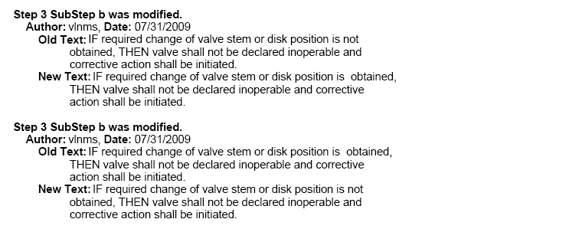
Chronology of Changes Report
Reports all changes made
Changed back to the original

Slide 23
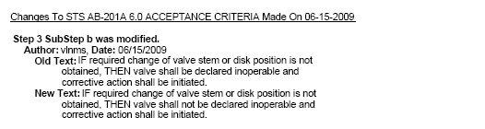
Summary of Change Report
Reports only changes from starting point to ending point
List of Transitions to Procedure E-0

Slide 24
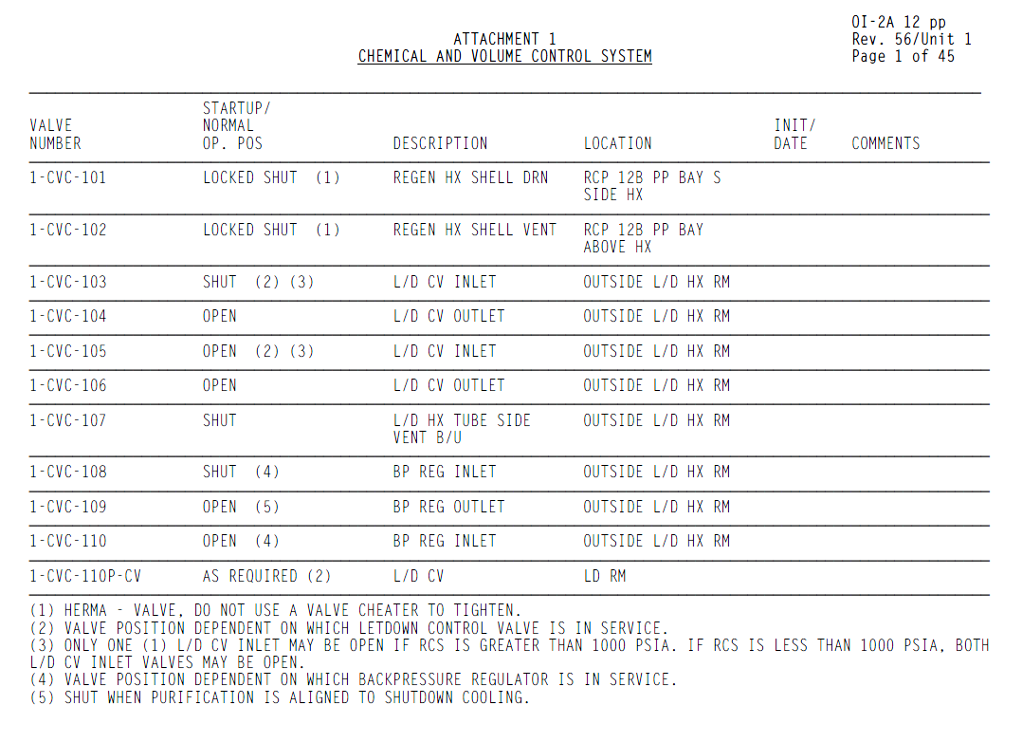
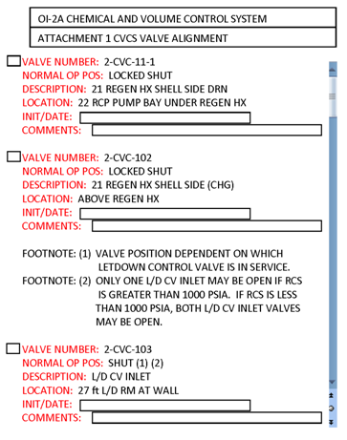
Customized Displays
Table Representation of Valve List
PDA Representation
of Valve List

Slide 25
PROMS2010 Cost Savings
Procedure Writer can concentrate on procedure content (time savings of 50%-75%)
Improved consistency of step layout and content
Manages hyperlinks for branching and referenced objects saving time, insuring technical accuracy, and locating errors
Pre-defined Reports help to create, administer, and maintain procedures
Easily perform Global Changes to the Format or Procedure Structure
Background and Support Documentation is Readily Available

Slide 26
Obtaining PROMS2010
Resolve Uncertainties:
  Implementation schedule
  Format specifications
  Conversion volume and consistency
  Scope definition
Sample Base Scope
  Site license for new NPP (existing customers will get sizable discount)
  Convert Westinghouse-provided procedure data into PROMS2010
  Incorporate plant formats and custom features
  Delivery – Installation, Training
  Maintenance & Upgrade
Optional services
  Plant specific conversion
  RO setup, linkage, and porting/synching
  Supporting or Auxiliary document integration
  Develop new features
  Interface with CR digital display and CBPS
  Convert PROMS2010 data to MS-WORD (optional)

Slide 27
Conversion Of Word Data to PROMS
    Totally Manual Process
    Totally Automated Process
Increasing Cost of Conversion Software
Decreasing Cost of Conversion Manpower

Slide 28
Attributes of Word Files That Determine Degree of Automation
Evaluation determines optimum configuration
  Best if all procedures are looked at
  Requires interaction with AP1000 Builder’s Group or the utility e.g. valve lists
Total number and size of the procedures being converted
  The greater the number and size of the procedures moves the optimum point for the amount of conversion automation toward the full automation.
Consistency of the Word procedures
  The more consistent the procedures are in Word also moves the optimum point for the amount of conversion automation toward the full automation.

Slide 29
Attributes of Word Files That Determine Degree of Automation
Evaluation determines optimum configuration
  Best if all procedures are looked at
  Requires interaction with AP1000 Builder’s Group or the utility e.g. valve lists
Total number and size of the procedures being converted
  The greater the number and size of the procedures moves the optimum point for the amount of conversion automation toward the full automation.
Consistency of the Word procedures
  The more consistent the procedures are in Word also moves the optimum point for the amount of conversion automation toward the full automation.
Whenever Volian is awarded a contract for VE-PROMS, we evaluate the procedures and determines the optimal amount of automation to include for the conversion process. The conversion of the data into VE-PROMS is included in the cost of the software product.

Slide 30
Conversion Processes
    Totally Manual Process
    Totally Automated Process
Semi-Manual Process using software that grabs a “chunk” of text for the author to enter in the appropriate location.
Rule-based automation that “learns” as it goes. When the converter reaches a “chunk” of text it does not recognize, it stops so that a rule can be created.
Rule-based automation that converts entire set and provides either a list of inconsistencies or adds a comment for the procedure writer to review and correct if necessary

Slide 31
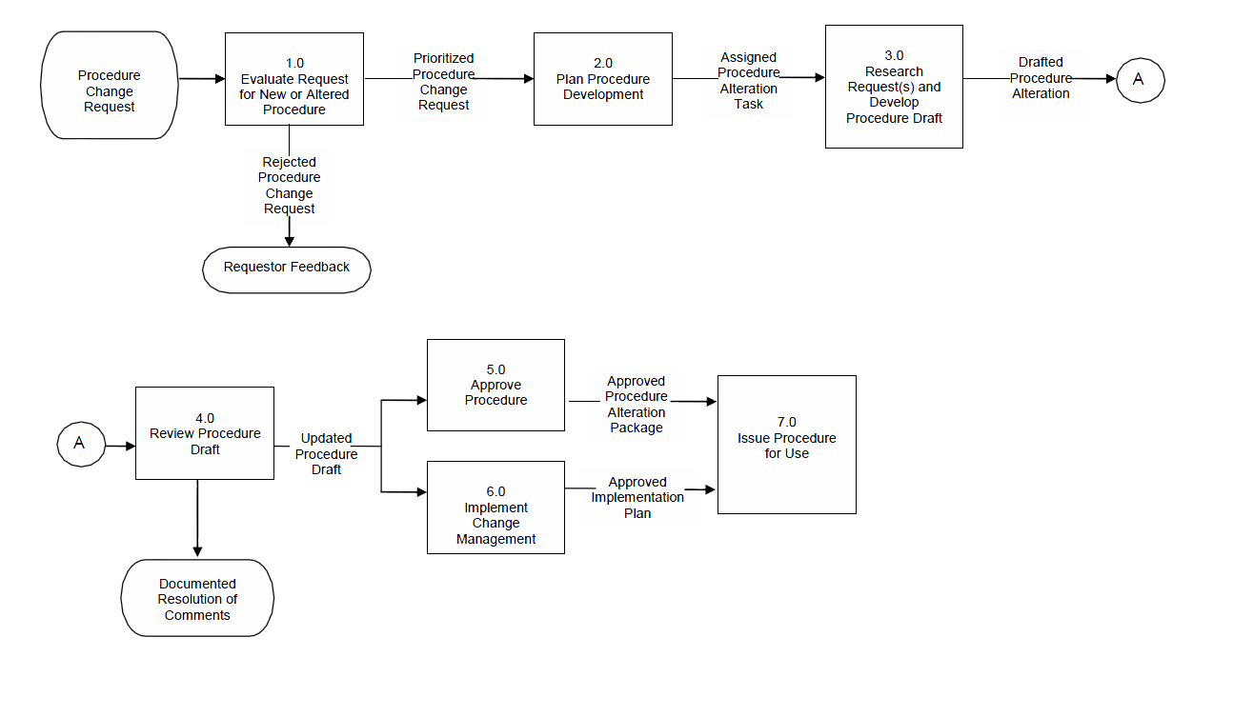
NEI AP-907-001 Procedure Process Description

Slide 32
PROMS2010 Procedure Workflow Features
Enhanced Background Document
Referenced Objects
Publishing
Change Manager
Approval

Slide 33
Adobe Acrobat Workflow
Adobe Workflow for PDF document format
  Adobe Acrobat for Procedure Writer
  Adobe Reader for Reviewers and Approvers
Built-in Live Collaboration using Acrobat.com
Review and Commenting Tools Activated in Adobe Reader
  Sticky notes, strike through, highlighting, marking inserted text, reconcile multiple comment instances one time
  Store comments on central server or on Adobe Website:
    Simple folder
    WebDAV folder
    Microsoft SharePoint Workspace
  Email or shared commenting
Approval Workflow
  Digital Signatures
  Approval Workflow Wizard easily sets up process
  Email notification of progress

Slide 34
Summary
Volian Enterprises, Inc. is experienced with all aspects of supporting plant procedures including the development of the leading procedure maintenance software in the nuclear industry
PROMS pays for itself with the improved efficiency during procedure creation and maintenance process
PROMS contains features that have more breadth and depth than competition plus unique features like Master/Slave
PROMS improves quality of procedures
  Referenced objects, change manager, master/slave
  Built-in Writers Guide and human factors rules
  Human reliability and regulatory compliance
PROMS makes it easier and faster to update procedures
The “Total Cost of Ownership” of PROMS is much less than any other alternative!

Slide 35

Thank you for your attention
Questions?

Slide 36
Extra Slides

Slide 37
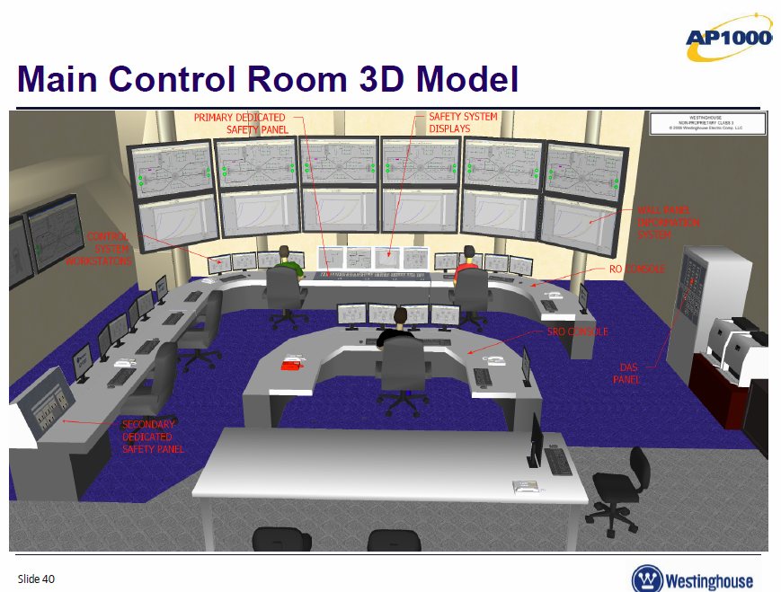

Slide 38
Builder’s Group Electronic Procedures Software Specification
PROMS2010 is a database design
Data linked to procedure text is internal to PROMS so that it can be controlled and managed.
For Workflow functionality we recommend using PDF output with Adobe Acrobat workflow functions and the plant’s enterprise workflow system. Several of our customers successfully utilize this configuration.
Our design allows us to easily display the procedure information in various views of PDA’s, tablet PCs, and other devices.

Slide 39
Volian’s PROcedure Maintenance System
Built-in Format and Structure
  Tool for consistent procedures
    Separate format and content allows universal changes to format and views
    Structure stored in database allows control of step and substep usage
    Strict compliance with Writer’s Guide eliminates formatting inconsistencies
  Simplifies formatting interface
    Eliminates user effort
    Built-in Human Factors rules
  Maximizes productivity of procedure writers
    Focus on content rather than publishing
    User can ignore formatting
    Working file, approved files automatically managed
    Supporting information (setpoints, component information) stored in one location

Slide 40
Volian’s PROcedure Maintenance System
Fast, Easy and Accurate Procedure Creation and Changes
  Little or no training necessary for procedure writers
  Tools for standard steps, replace words, page layout, pagination, graphs, global search
  Consistent numbering and step references (transitions)
  Referenced Objects allows a single point of entry to update equipment IDs, setpoints, images, etc.
  Transition and Referenced Object Usage Reports
Supports Procedure Change Process
  Track comments, commitments, open items
  Integrated technical basis (background and deviation documents)
  Working draft and approved procedures
  Chronology and Summary of Change Reports

Slide 41
PROMS2010
More Flexible
  Organization of procedures
  Complete windows font support
  Edit multiple procedures concurrently
Simpler
  Intuitive user interface
  Multi-user access
  Integration of .pdf file creation for printing and document control

Slide 42
Attributes of Document Maintenance System
Documents will change over time
  Address changes to the plant (mods)
  Continuous improvement
  New issues
Documents are highly structured
  Strict Writer’s Guide requirements
  QA and Administrative requirements

Slide 43

Procedure Writer Without Procedure Maintenance System

Slide 44
APP-GW-GJP-100 8 of 94
Westinghouse Non-Proprietary Class 3
Writer's Guideline For Normal Operating Procedures APP-GW-GJP-100 Revision H
3.5 Collecting Information
3.5.1 The procedure writer collects technical and user information.
3.5.2 Both technical and user information are equally important since a technically accurate procedure may not be user friendly if the user was not considered during the development process.
3.5.3 To ensure technical accuracy, the most recent up-to-date technical information must be collected.
3.5.4 Sources for such information may include, but are not limited to:
* AP1000 Piping and Instrumentation Diagrams
* AP1000 Logic Drawings
* AP1000 Technical Specifications
* AP1000 System Specification Documents
* AP1000 Design Control Document
* AP1000 Accident Analysis
* AP1000 Setpoint Document
* Vendor Technical Information
* Test and Performance Acceptance Criteria
3.5.5 The user information collected will aid the procedure writer in determining an appropriate level of detail.
Notes:
Could add CR Video Displays , walk downs, etc.
This is a monumental job now and will only get more complex as plant is built and operates over 60 years.
Fertile ground for Procedure Maintenance enhancements

Slide 45
Produce highest quality NPP procedures at a reasonable cost throughout the plant lifetime
Procedure maintenance is a necessary activity and presents an opportunity to improve plant performance.
A procedure maintenance system, PROMS2010, depends on whether
Is this TRUE or FALSE: Minimizing procedure changes minimizes costs.
Is procedure maintenance basically keeping up with changes to the plant procedures or and coping with the administrative/QA requirements? Or does the procedure
Which option is the lowest cost of ownership in the long term?

